Slide 1
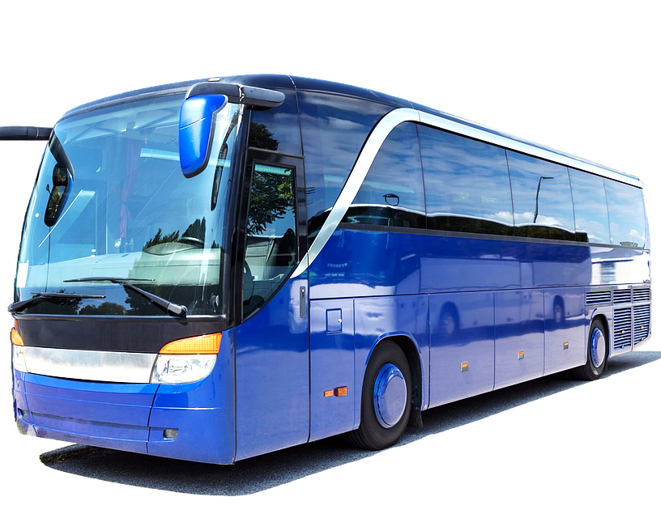
VELOCITY VOYAGER
BUS MANAGEMENT SYSTEM
Developed By
SHOBHA DS
VENKATESH SD
SINDHU HK

Slide 2
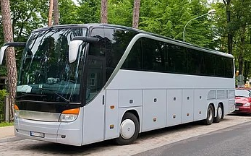
CONTENTS
Introduction
Objectives
Problem Statement
Module Description
Conclusion

Slide 3
INTRODUCTION
As we all know, public transportation plays a crucial role in our daily lives, connecting us to work, school, and other important destinations. However, managing a fleet of buses can be a complex and challenging task, requiring careful planning and coordination. That's where bus management systems come in - they provide a comprehensive solution for optimizing bus operations and improving the overall passenger experience.
we'll explore the benefits of bus management systems and how they can help transport agencies operate more efficiently, reduce costs, and enhance customer satisfaction.

Slide 4
Problem Statement
Our task is to develop a Bus Management System that provides a comprehensive set of features to manage and optimize bus operations efficiently. The system should be user-friendly, secure, and scalable to accommodate a large number of buses, routes, and passengers.

Slide 5
Objectives
The primary objective of the bus management system is to improve the overall efficiency of the transportation system
The bus management system provides passengers with real-time information about bus schedules and locations, allowing them to plan their journeys more effectively
The system can help to reduce overcrowding on buses and improve safety by monitoring passenger numbers and providing alerts when capacity limits are reached.

Slide 6
Module Description
Bus Registration:
Bus operators should be able to register their buses into the system with details such as bus number, seating capacity, model, and other relevant information.
Route Management:
Admins should be able to define various bus routes with starting and ending points, intermediate stops, and associated fares.
Schedule Management:
Admins should be able to create and modify bus schedules based on defined routes and assign buses to specific schedules.

Slide 7
Booking System:
Passengers should be able to search for available buses based on their preferred routes, view schedules, and book seats.
The system should provide real-time seat availability information to passengers during the booking process.
Ticketing and Payment:
The system should support online ticket booking and enable passengers to make secure payments using various payment methods.

Slide 8
Conclusion
In conclusion, the bus management system provides numerous benefits for efficient and effective public transportation. By implementing this system, we can optimize fleet and route management, improve passenger experience, and streamline ticketing processes, increased revenue for the transportation industry. With a reliable and convenient public transportation system, people can save time, reduce stress, and contribute to a more sustainable environment.

Slide 9


